Slide 1
PyBASC Update

Slide 2
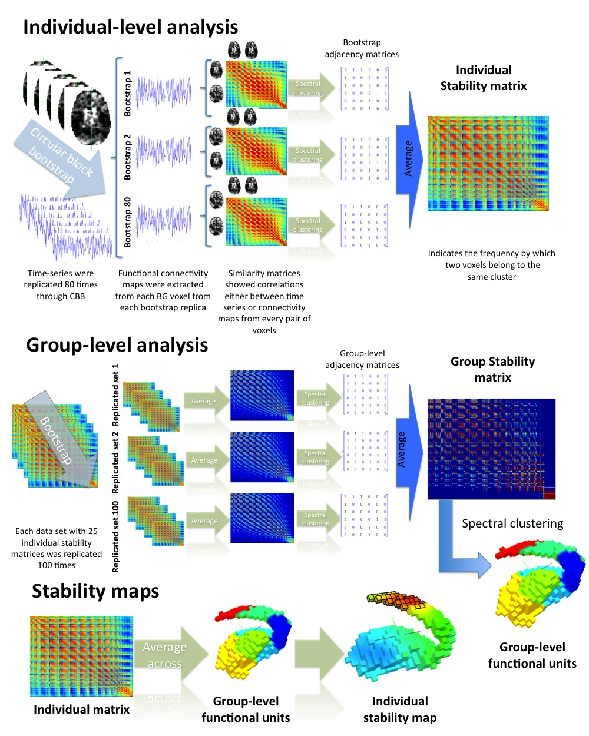

Slide 3
Items of Analysis:
Individual Stability Matrix
Group Stability Matrix
Group Cluster Assignment
Individualized Group Cluster Assignment

Slide 5
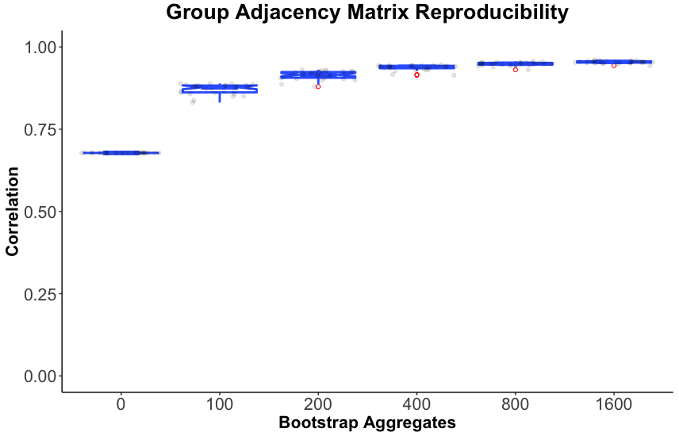
Group Level Spatial Correlation 50/50 split

Slide 6
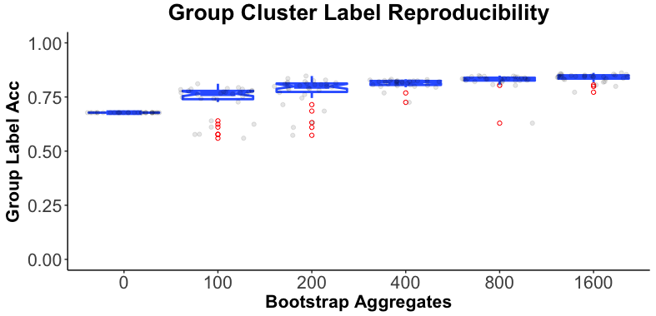
Group Level Rand Index 50/50 split

Slide 7
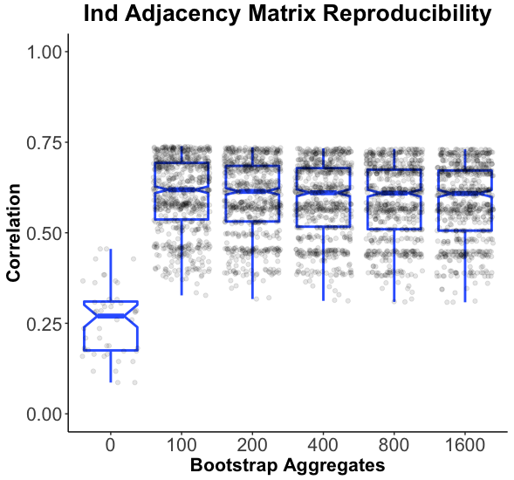
Individual Level Spatial Correlation 50/50 split

Slide 8
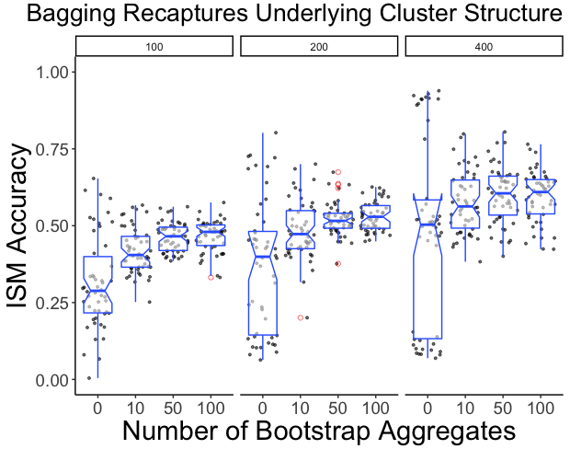
Spatial Correlation on Simulated Individual-Level Data
Max Theoretical Spatial Correlation: r = 0.707

Slide 9
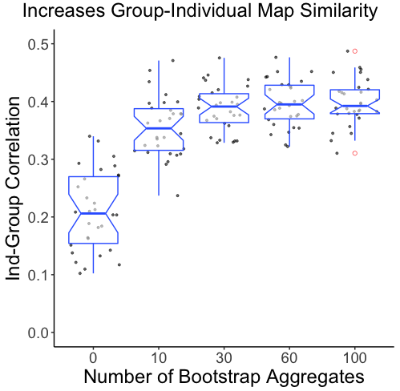
Individual-Group Spatial Correlation Simulated Data

Slide 10
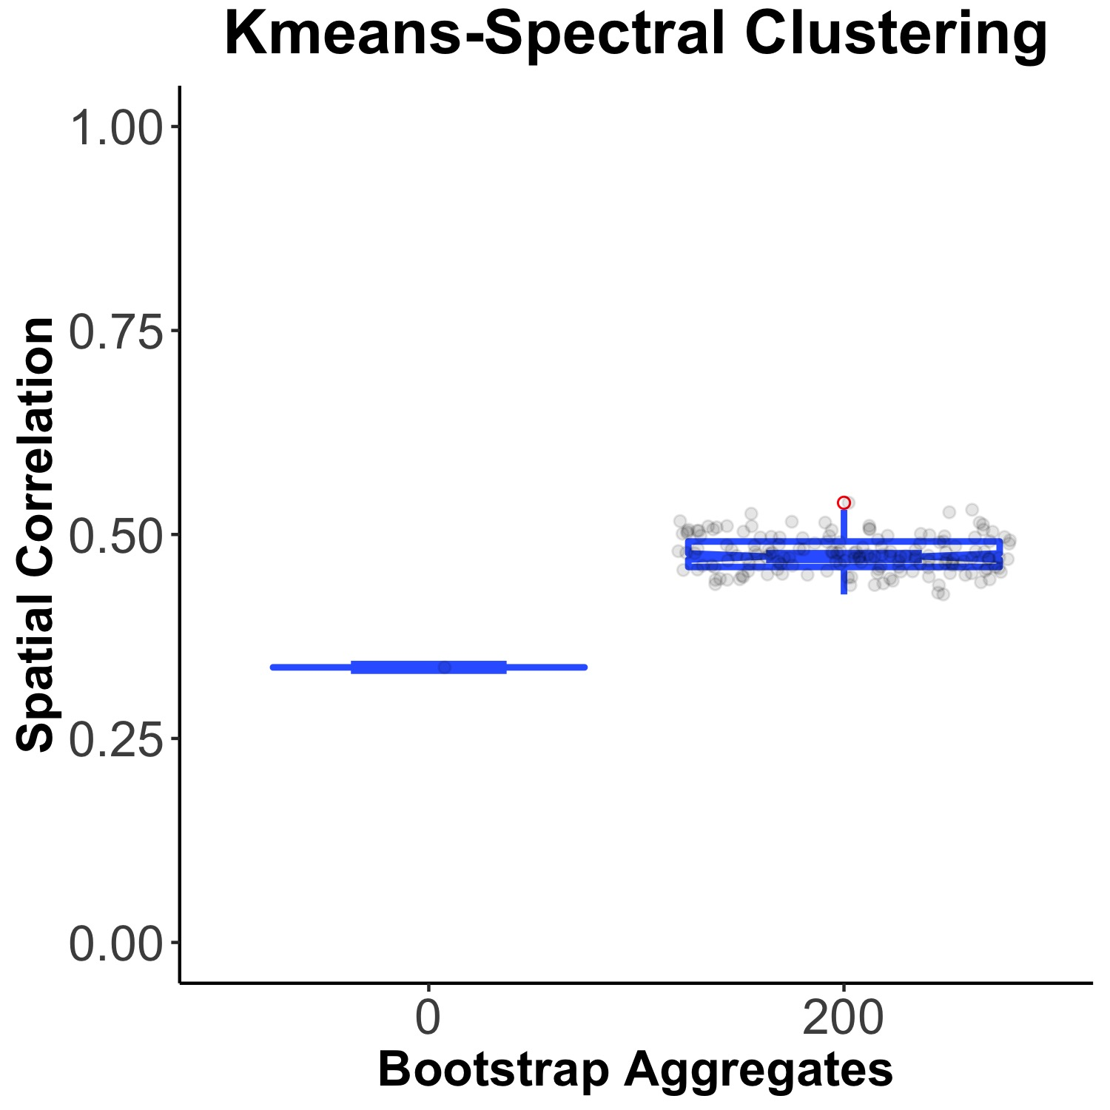
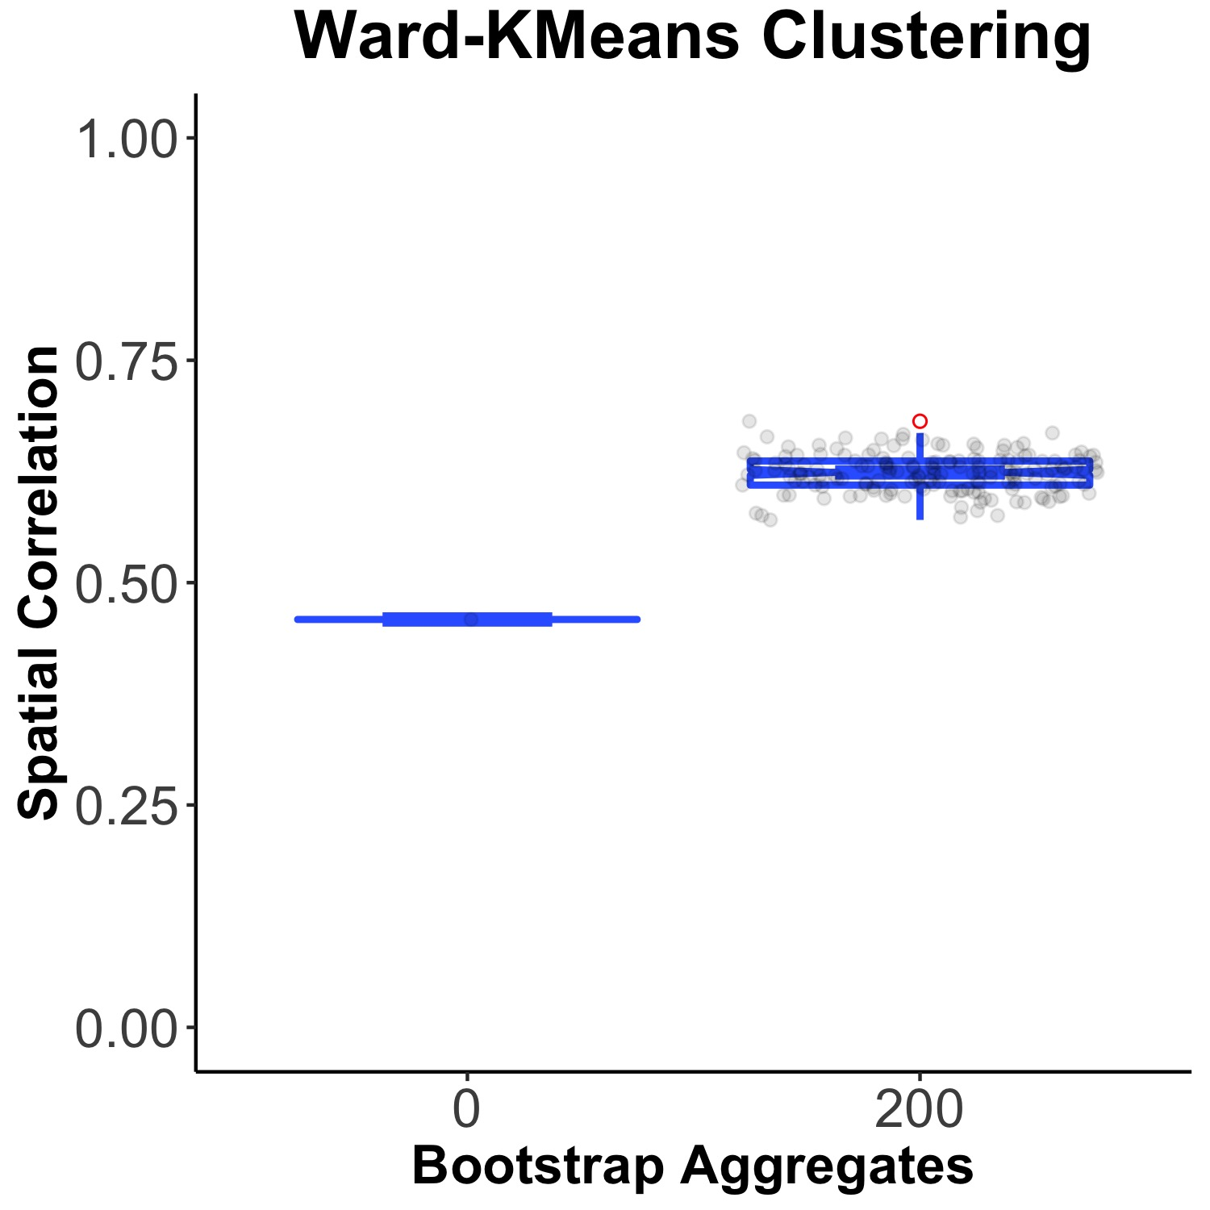
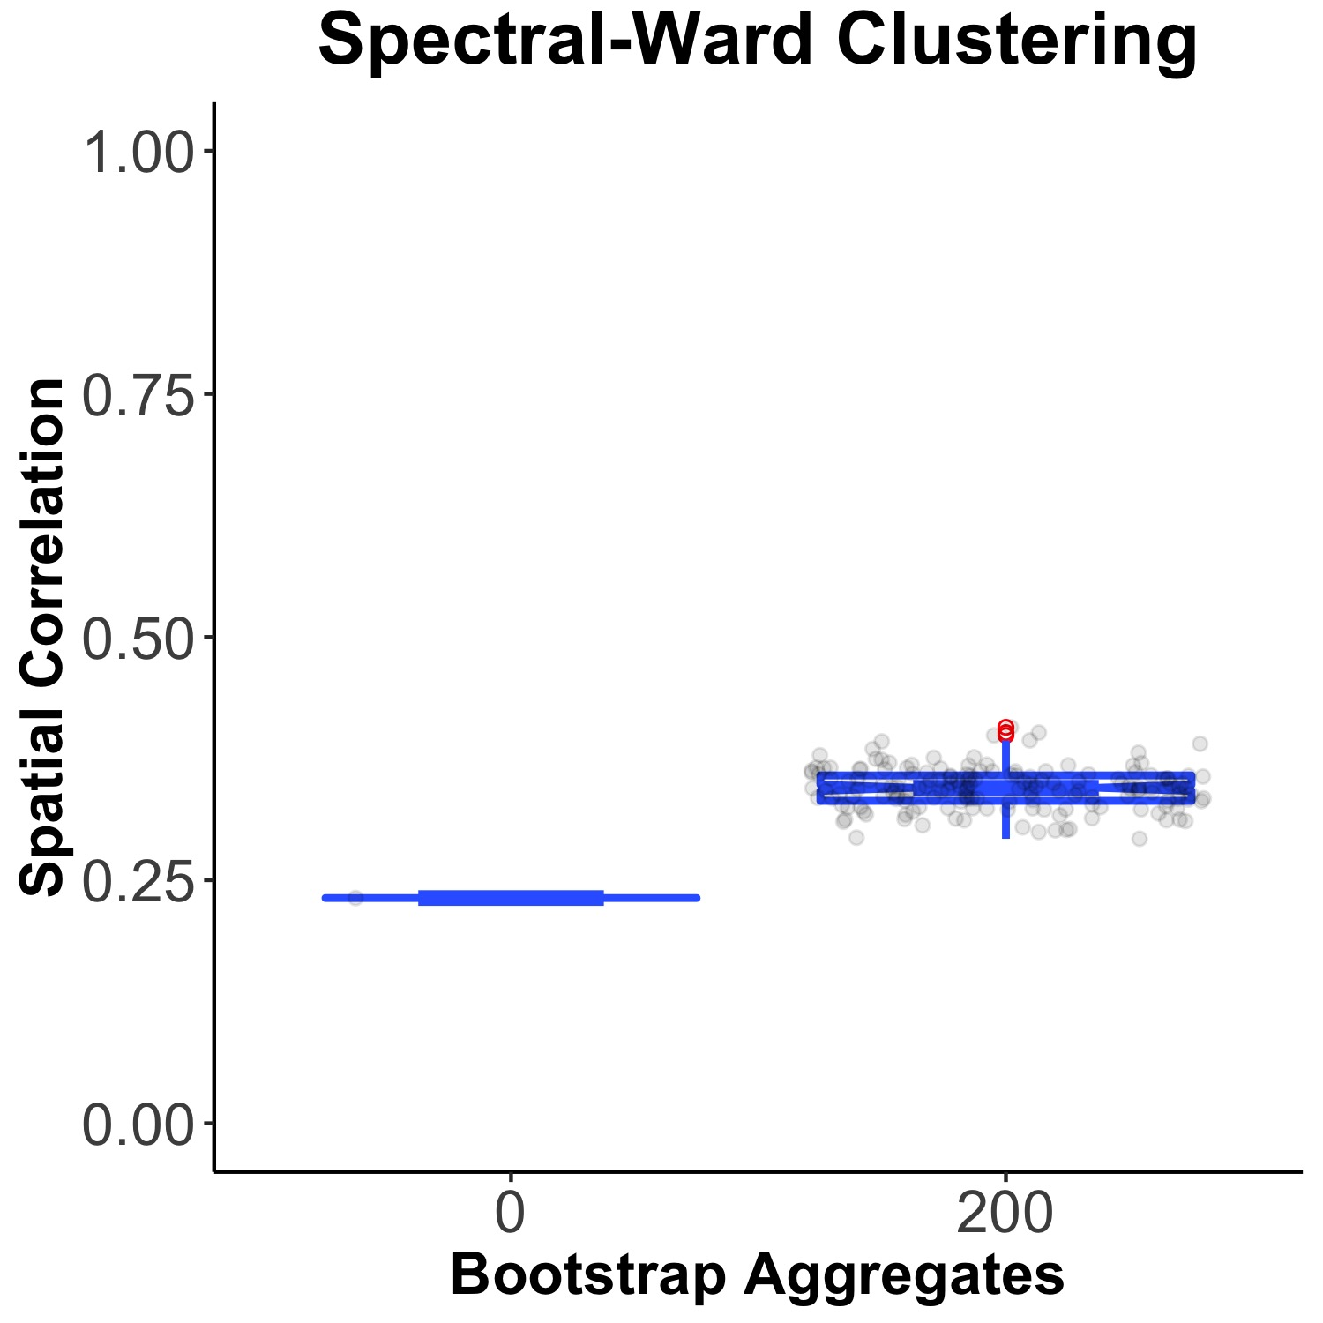
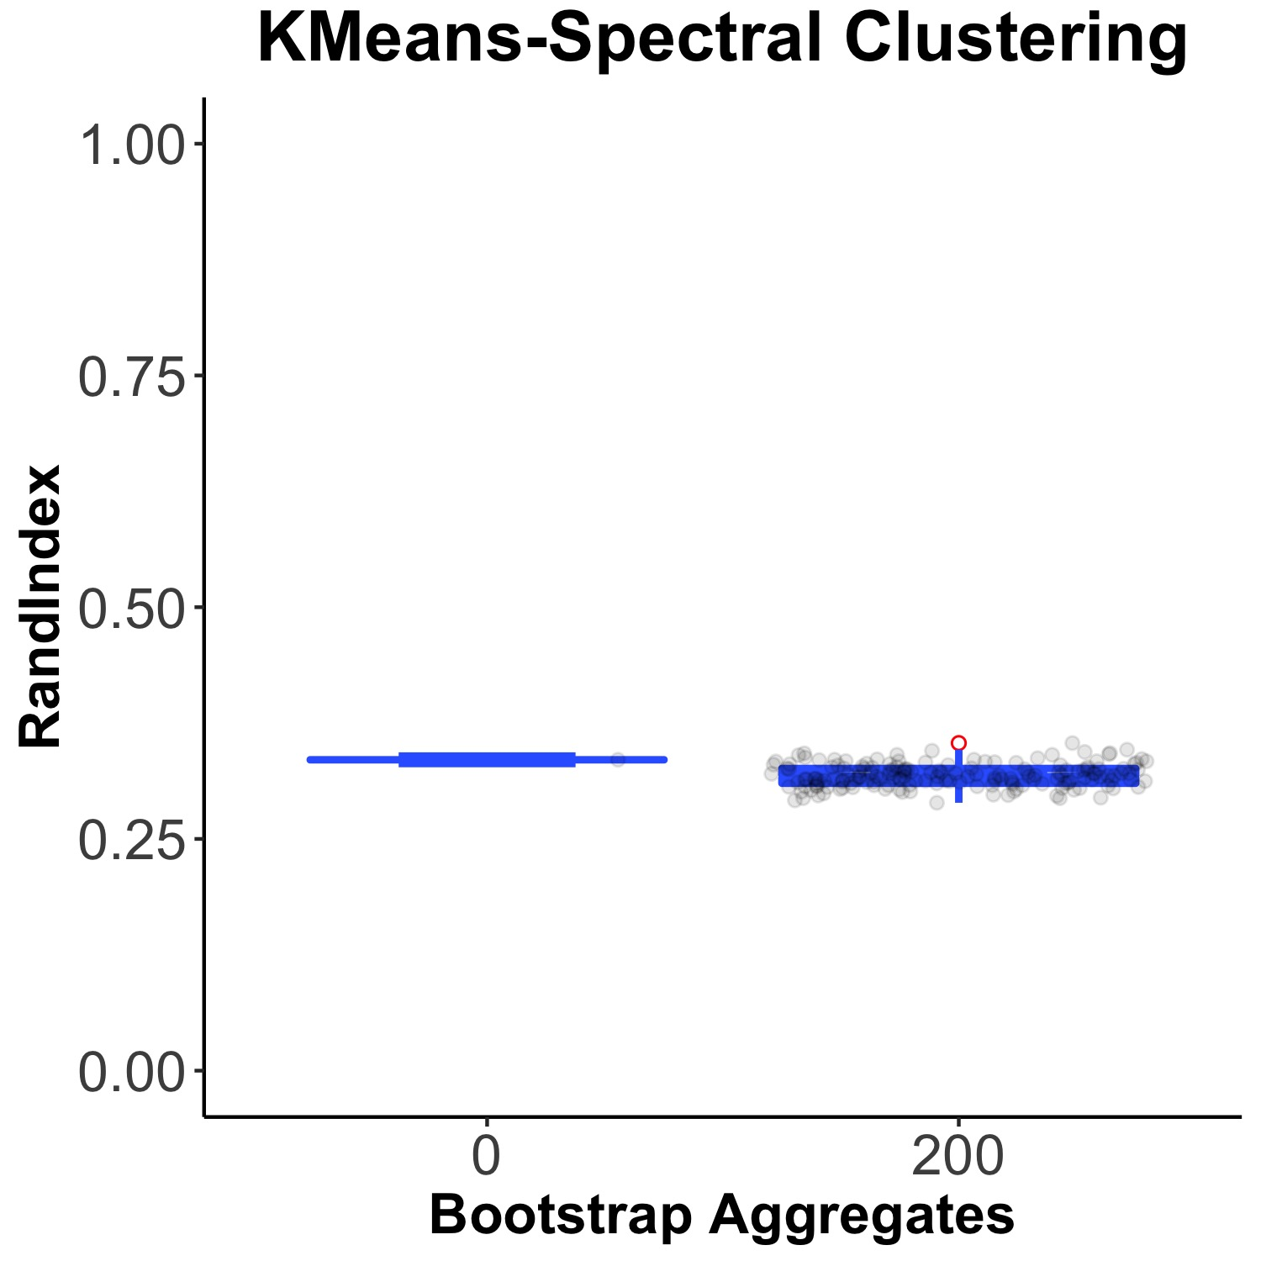
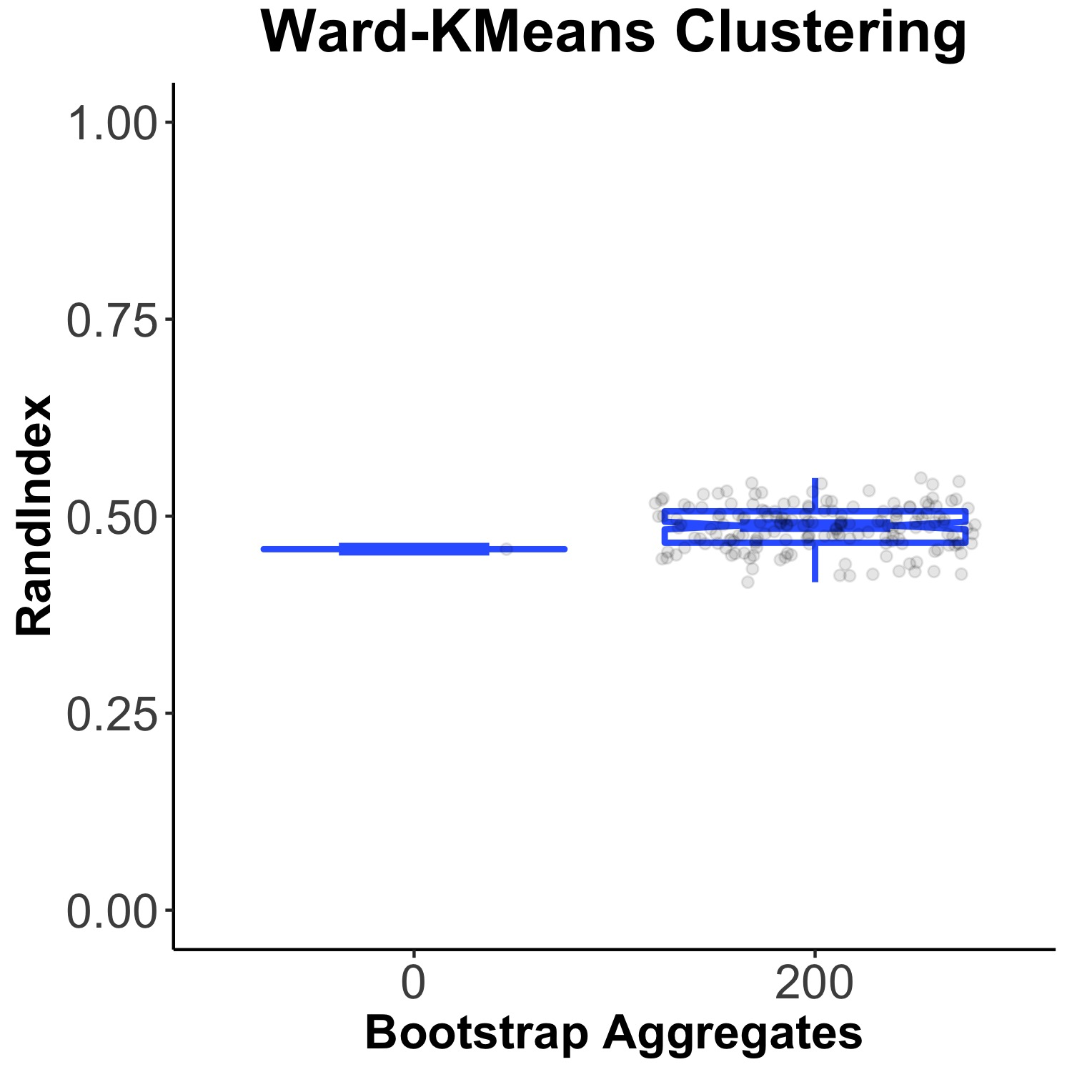
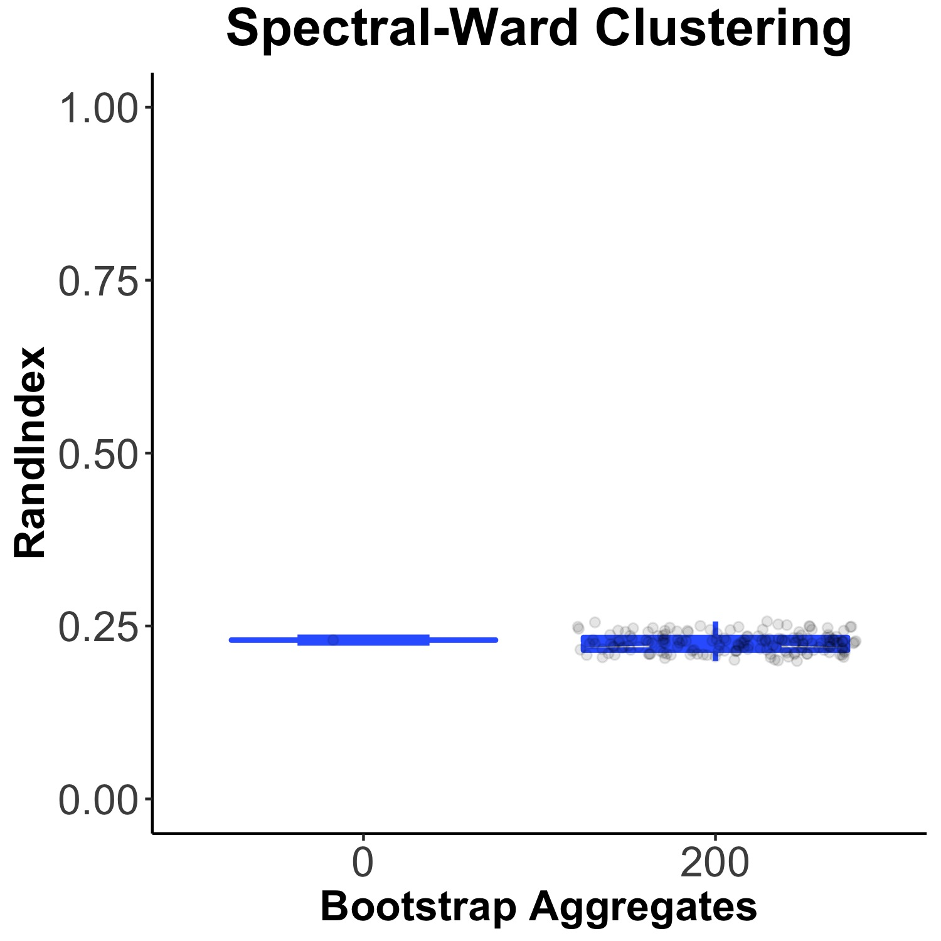
Clustering Similarity

Slide 11
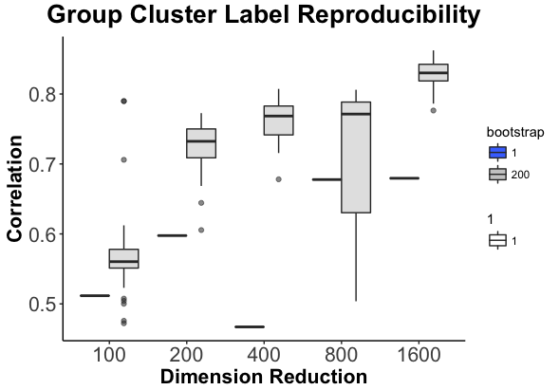
Group Level Rand Index- Group Dimension Reduction

Slide 12
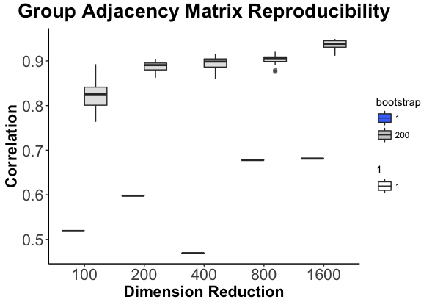
Group Level Spatial Correlation Group Dimension Reduction

Slide 13
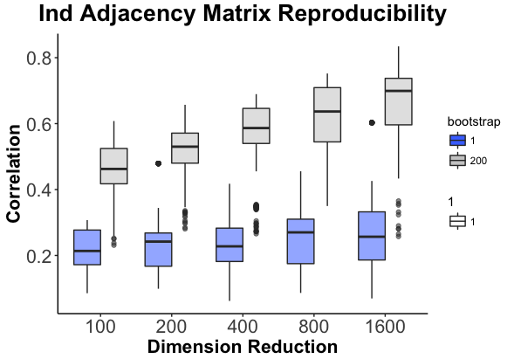
Ind. Level Spatial Correlation Group Dimension Reduction

Slide 14
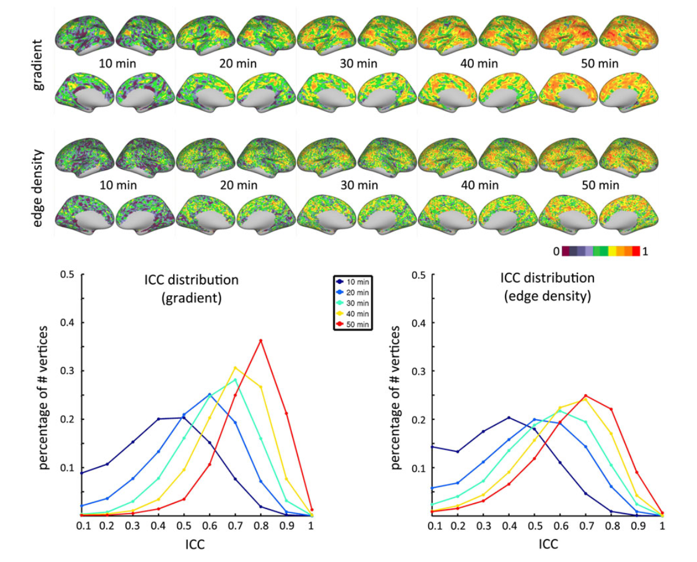

Slide 15
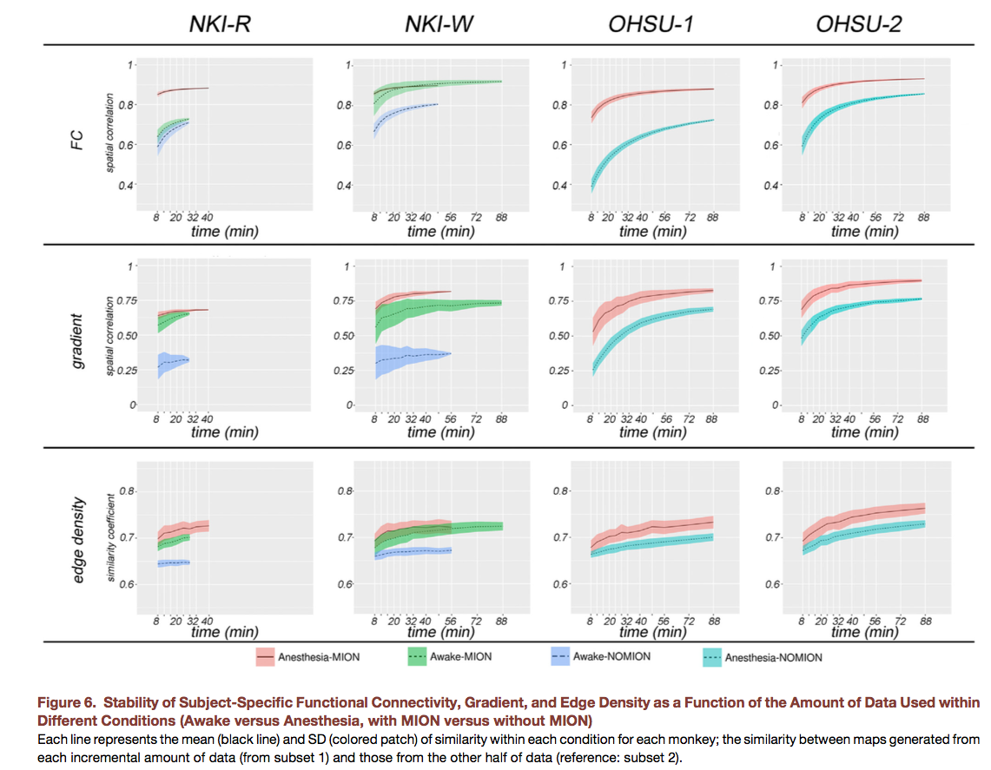

Slide 16
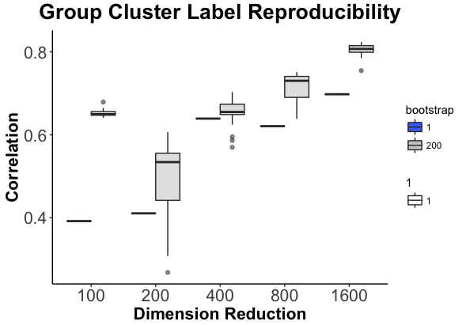
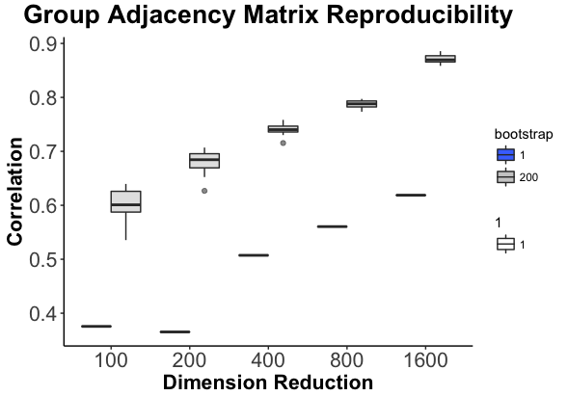
Individual Dim Reduce
Group Dim Reduce

